Slide 1
Topological Sorting

Slide 2
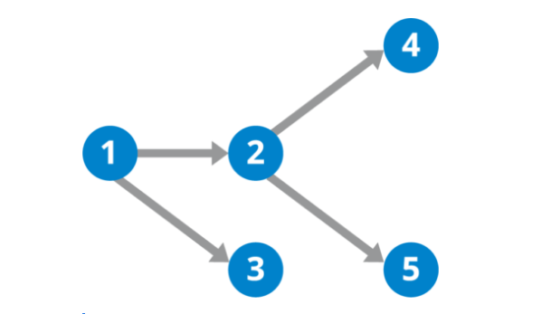
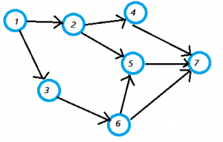
Directed Acyclic Graph
DAG – Directed graph with no cycles.

Slide 3
Topological Sorting
Topological sorting for Directed Acyclic Graph (DAG) is a linear ordering of vertices such that for every directed edge u v, vertex u comes before v in the ordering.
Topological Sorting for a graph is not possible if the graph is not a DAG.

Slide 4
Topological Sort
Want to “sort” a directed acyclic graph (DAG).
A
B
D
C
E
A
B
C
D
E
At the beginning, always try to pick nodes with no dependencies i.e.
incoming degree of node is 0.

Slide 5
Topological Sort
Performed on a DAG.
Linear ordering of the vertices of G such that if (u, v) ∈ E, then u appears somewhere before v.
Topological-Sort (G)
call DFS(G) to compute finishing times f [v] for all v ∈ V
as each vertex is finished, insert it onto the front of a linked list
return the linked list of vertices
Time: Θ(V + E).

Slide 6
Algorithm
Call dfs(g) for some graph g. The main reason we want to call depth first search is to compute the finish times for each of the vertices.
Store the vertices in a list in decreasing order of finish time.
Return the ordered list as the result of the topological sort.

Slide 7
Example
A
B
D
1/
C
E
Linked List:

Slide 8
Example
A
B
D
1/
2/
C
E
Linked List:

Slide 9
Example
A
B
D
1/
2/3
C
E
Linked List:
2/3
E

Slide 10
Example
A
B
D
1/4
2/3
C
E
Linked List:
1/4
2/3
D
E

Slide 11
Example
A
B
D
5/
1/4
2/3
C
E
Linked List:
1/4
2/3
D
E

Slide 12
Example
A
B
D
5/
1/4
6/
2/3
C
E
Linked List:
1/4
2/3
D
E

Slide 13
Example
A
B
D
5/
1/4
6/7
2/3
C
E
Linked List:
6/7
1/4
2/3
C
D
E

Slide 14
Example
A
B
D
5/8
1/4
6/7
2/3
C
E
Linked List:
5/8
6/7
1/4
2/3
B
C
D
E

Slide 15
Example
A
B
D
9/
5/8
1/4
6/7
2/3
C
E
Linked List:
5/8
6/7
1/4
2/3
B
C
D
E

Slide 16
Example
A
B
D
9/10
5/8
1/4
6/7
2/3
C
E
Linked List:
9/10
5/8
6/7
1/4
2/3
A
B
C
D
E

Slide 17
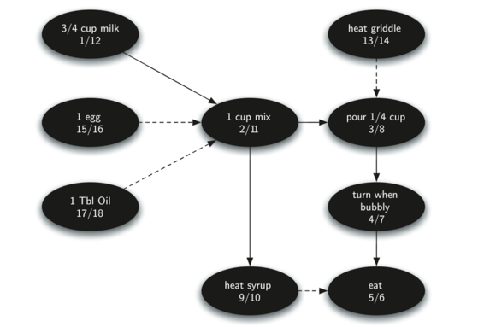
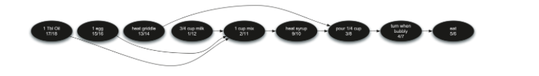
Example-2

Slide 18
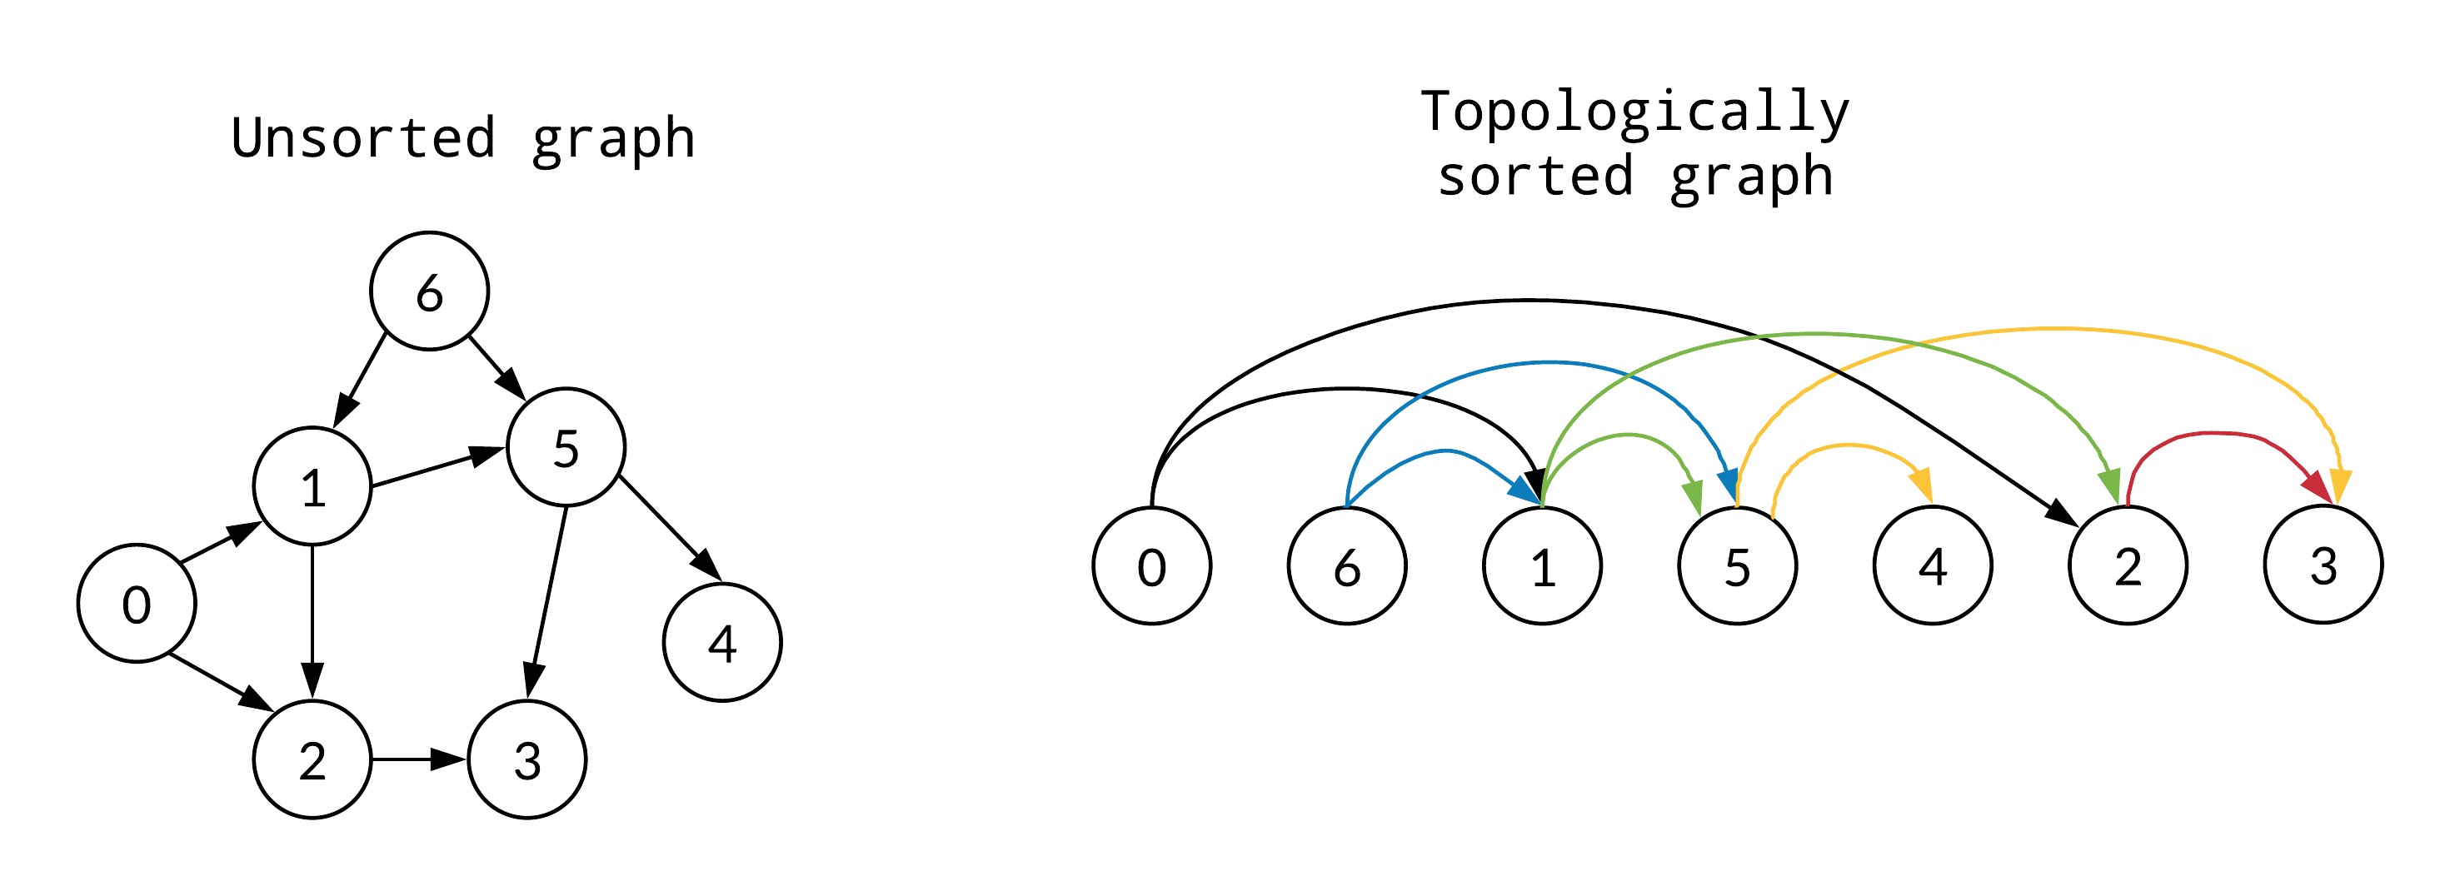
Example-3

Slide 19
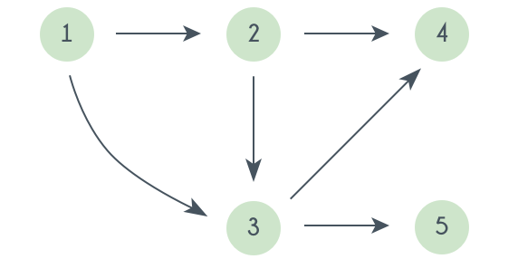
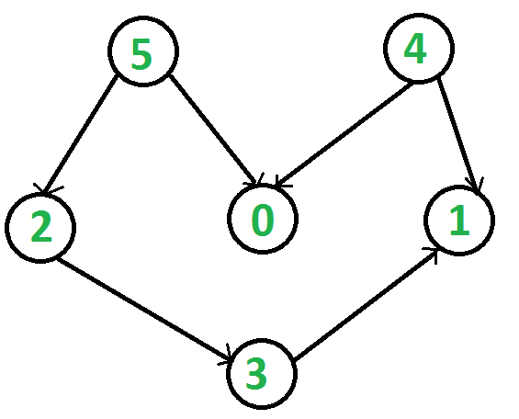
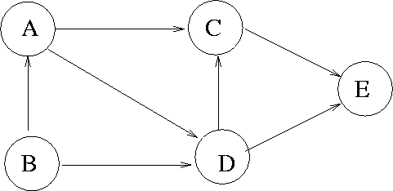
Exercises

Slide 20
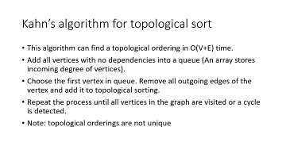
Kahn’s algorithm for topological sort
This algorithm can find a topological ordering in O(V+E) time.
Add all vertices with no dependencies into a queue (An array stores incoming degree of vertices).
Choose the first vertex in queue. Remove all outgoing edges of the vertex and add it to topological sorting.
Repeat the process until all vertices in the graph are visited or a cycle is detected.
Note: topological orderings are not unique

Slide 21
Example
Topological Sorting Array
Incoming vertex degree of vertices
1 | 2 | 3 | 4 | 5 | 6 | 7
0 | 1 | 1 | 1 | 2 | 1 | 3
Queue
1

Slide 22
Example
Topological Sorting Array
1
Incoming vertex degree of vertices
1 | 2 | 3 | 4 | 5 | 6 | 7
0 | 0 | 0 | 1 | 2 | 1 | 3
Queue (Incoming vertex degree=0)
2 | 3

Slide 23
Example
Topological Sorting Array
1 | 2
Incoming vertex degree of vertices
1 | 2 | 3 | 4 | 5 | 6 | 7
0 | 0 | 0 | 0 | 1 | 1 | 3
Queue (Incoming vertex degree=0)
3 | 4

Slide 24
Example
Topological Sorting Array
1 | 2 | 3
Incoming vertex degree of vertices
1 | 2 | 3 | 4 | 5 | 6 | 7
0 | 0 | 0 | 0 | 1 | 0 | 3
Queue (Incoming vertex degree=0)
4 | 6

Slide 25
Example
Topological Sorting Array
1 | 2 | 3 | 4
Incoming vertex degree of vertices
1 | 2 | 3 | 4 | 5 | 6 | 7
0 | 0 | 0 | 0 | 1 | 0 | 2
Queue (Incoming vertex degree=0)
6

Slide 26
Example
Topological Sorting Array
1 | 2 | 3 | 4 | 6
Incoming vertex degree of vertices
1 | 2 | 3 | 4 | 5 | 6 | 7
0 | 0 | 0 | 0 | 0 | 0 | 1
Queue (Incoming vertex degree=0)
5

Slide 27
Example
Topological Sorting Array
1 | 2 | 3 | 4 | 6 | 5
Incoming vertex degree of vertices
1 | 2 | 3 | 4 | 5 | 6 | 7
0 | 0 | 0 | 0 | 0 | 0 | 0
Queue (Incoming vertex degree=0)
7

Slide 28
Example
Topological Sorting Array
1 | 2 | 3 | 4 | 6 | 5 | 7
Incoming vertex degree of vertices
1 | 2 | 3 | 4 | 5 | 6 | 7
0 | 0 | 0 | 0 | 0 | 0 | 0
Queue (Incoming vertex degree=0)

Slide 30
Application of Topological Sort
Topological Sorting is mainly used for scheduling jobs from the given dependencies among jobs.
In computer science, applications of this type arise in Prerequisite courses, Program dependencies/Building systems, Event scheduling, instruction scheduling, ordering of formula cell evaluation when recomputing formula values in spreadsheets, logic synthesis, determining the order of compilation tasks to perform in make files, data serialization, and resolving symbol dependencies in linkers.
A graph that contains a cycle (cyclic graph) cannot have valid sorting.
All rooted trees have topological ordering since there are no cycles.

